Slide 1
Metaheuristic Algorithms to Balance Robotic Assembly Lines
S. G. PONNAMBALAM
Professor
Faculty of Manufacturing & Mechatronics Engineering Technology
University Malaysia Pahang, Malaysia
sgponnambalam@ump.edu.my

Slide 2
Outline
ALB
RALB
Metaheuristic Algorithms
PSO for RALB-II
Industry 4.0
Future Research Directions
Q & A

Slide 3
Assembly Line Balancing
Assembly Line – first developed by Ford Motor Company in 1900s.
Ford installed the first moving assembly line-December 1, 1913.
His innovation reduced the time it took to assemble a chassis from more than 12 hours to two hours and 30 minutes.
What is meant by Balancing?
The process of equalizing the amount of work at each workstation on an assembly line.
To work effectively, with no work pile-ups between stations, the line must be balanced.

Slide 4
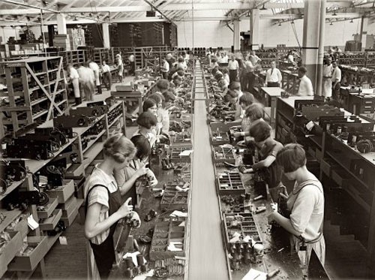
Why to balance Assembly Lines?
Assembly Line Balancing is a classical optimization problem.
Why to Balance an Assembly Line?
Improvement of:
efficiency
production rate
productivity
Reduction of:
idle time
production cost

Slide 5

Unbalance Issues in Assembly Lines
Overproduction which causes wastes
Over-processing
Inventory
Waiting
Transportation
5 mins
25 mins
15 mins
10 mins
1
2
3
4
This operator must WAIT for operator 2
This operator must WAIT for operator 3
Constraint
Overburden
25
20
mins
15
10
5
1
2
Station
3
4

Slide 6
Assembly Line Balance : Simple Example
Promotes one-piece FLOW
Avoids overburden
Minimizes wastes
15 mins
15 mins
15 mins
10 mins
1
2
3
4
Redistribute the work
25
20
Time (mins)
15
10
5
Stations

Slide 7
Classification of ALB Problems
ALB was first mathematically formulated by Helgeson in 1954.
ALB Types
Model Type
Single Model
Multi Model
Problem Structure
Simple ALB
Mixed Model
SALB-I
SALB-II
Automated ALB
RALB
FALB

Slide 8

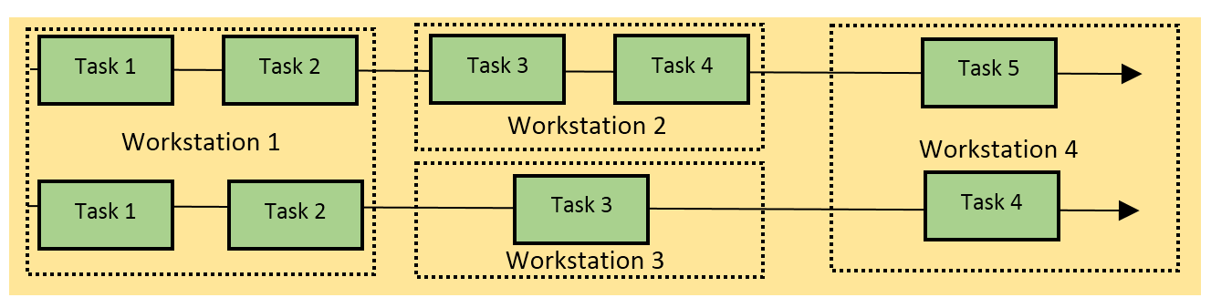

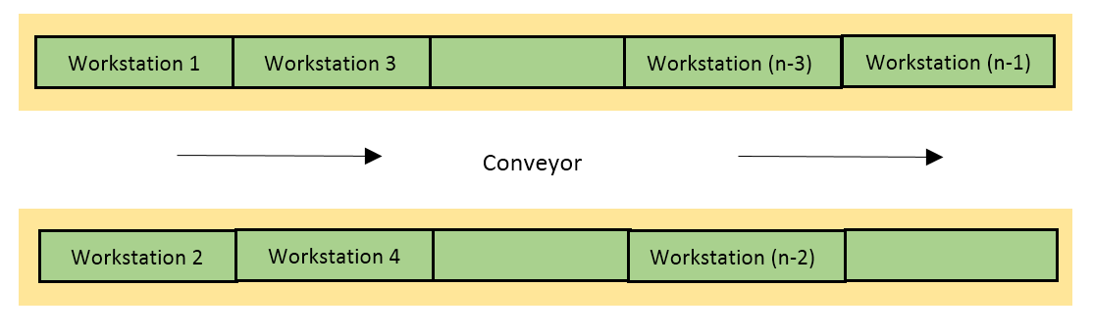

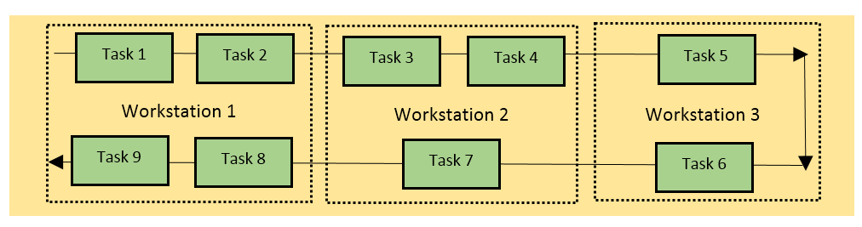
ALB problems based on models & layout
Single Model Assembly Line
Parallel Assembly Line
Multi Model Assembly Line
Mixed Model Assembly Line
Two Sided Assembly Line
U-shaped Assembly Line

Slide 9
ALB - Objectives
Minimize
Maximize
assembly cost
assembly time
cycle time
number of workstation
idle time
workload smoothness
line efficiency
utilization

Slide 10
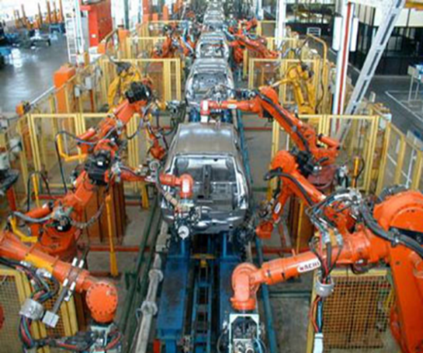
Robotic Assembly Lines
Robot can work 24 hours a day without fatigue.
Goals for implementation of robotic assembly lines
high productivity
quality of product
manufacturing flexibility
safety
Performance of RALs depends on the quality of its balance.
RALB also falls under the category of NP-hard .

Slide 11
RALB Problem: Classifications
RALBP TYPE I – Aims at reducing number of workstations by assigning best suited robots and tasks to workstations.
RALBP TYPE II – Aims at minimising cycle time with predefined number of workstations.
RALBP TYPE E – Aims at reducing both cycle time and workstations thus maximising the assembly line efficiency.
RALBP TYPE F – Aims at finding feasible solutions for a predefined set of workstations and cycle times.
RAL BP TYPE COST – Aims at monetary and economic aspects of RAL.
Structures: multi-manned, parallel workstation, U-shaped, straight line, two sided), parallel U-line, parallel adjacent U-line), parallel multi-manned.

Slide 12
Key Research on RALB-I
Source | Model | Solution Procedure
Rubinovitz et al. (1993) | Minimization of workstations for a given cycle time | Heuristics
Tsai and Yao (1993) | Determine the robot type and number of robots required in each workstation. Minimize the SD of output rates of all workstations. | Integer programming model and simulation adjustment procedure
Bukchin and Tzur (2000) | Minimize equipment cost for a predetermined cycle time | Branch and Bound Algorithm

Slide 13
Key Research on RALB-II
Source | Model | Solution Procedure
Levitin et al. (2006) | Assignment of tasks to workstations and selection of best fit robot in such way the cycle time is minimized. | Two versions of GA local exchange procedure to improve the quality of the solution
Gao et al.(2009) | Minimize cycle time. | Hybrid Genetic Algorithm
Yoosefelahi et al.(2012) | Minimize the cycle time, robot setup costs and robot costs. | Mixed-integer linear programming model is developed. Multi-objective evolution strategies (MOES) are developed.

Slide 14
Key Research on RALB-II
Source | Model | Solution Procedure
Nilakantan et al. (2015) | Minimize cycle time in a straight robotic assembly line | Particle Swarm Optimization (PSO) Hybrid Cuckoo search and PSO
Nilakantan and Ponnambalam (2016) | Minimize cycle time in a U-shaped robotic assembly line | New heuristic algorithm for allocation in a U-shaped assembly line Particle Swarm Optimization (PSO)

Slide 15
Key Research on RALB-II
Source | Model | Solution Procedure
Li et al. (2016) | Minimize cycle time in a two-sided robotic assembly line | Mixed integer programming model, solved using CPLEX Co-evolutionary particle swarm optimization algorithm Local searches and restart mechanism
Tang et al. (2016) | Minimize idle time in a two sided robotic assembly line | Discrete artificial bee colony algorithm
Çil et al. (2017) | Minimize the cycle time in a mixed model robotic assembly line | Beam Search (BS) algorithm Mixed integer programming model Versions of BS proposed

Slide 16
Key Research on RALB- Reviews
Source | Model | Solution Procedure
Parames Chutima (2020) | A comprehensive review of robotic assembly line balancing problem. | All types of RALB problem approaches till 2020 reviewed including classifications, solution methods, layout considerations.
Nils Boysen, Philipp Schulze, Armin Scholl (2021) | Assembly line balancing: What happened in the last fifteen years? | Reviewed all types of assembly line problem & solution approaches proposed.

Slide 17
Key Research on RALB- other objectives
Source | Model | Solution Procedure
Daoud et al. (2014) | Maximize line efficiency | Three evolutionary algorithms and local search
Nilakantan et al. (2015) | Minimize energy consumption and cycle time in a straight robotic assembly line | Particle Swarm Optimization 0-1 integer programming model
Nilakantan et al. (2017) | Minimize assembly line cost in a straight robotic assembly line | Differential Evolution algorithm
Nilakantan et al. (2016) | Maximize line efficiency of straight and U-shaped assembly lines | Particle Swarm Optimization Differential Evolution algorithm
Nilakantan et al. (2017) | Minimize the total carbon footprint and maximize the efficiency of robotic assembly line systems | Multi-objective co-operative co-evolutionary algorithm

Slide 18
Key Research on RALB-other objectives
Source | Model | Solution Procedure
Cil et al. (2016) | Minimizing cycle time, number of workstation and robot cost, are considered. | Goal programming approach
Li et al. (2018) | Minimize make span in a robotic mixed model assembly line | Simulated annealing algorithm with restarts Co-evolutionary algorithm
Nilakantan et al. (2018) | Maximizing line efficiency by minimizing energy consumption | Particle Swarm Optimization Differential Evolution
Zixiang et al. (2019) | Minimizing Cycle time. Mixed Integer LPP. Two-sided assembly line balancing problems with setup times | 13 metaheuristic algorithms

Slide 19
Key Research on RALB-other objectives
Source | Model | Solution Procedure
Cil et al. (2016) | Minimizing cycle time, number of workstation and robot cost, are considered. | Goal programming approach
Li et al. (2018) | Minimize make span in a robotic mixed model assembly line | Simulated annealing algorithm with restarts Co-evolutionary algorithm
Nilakantan et al. (2018) | Maximizing line efficiency by minimizing energy consumption | Particle Swarm Optimization Differential Evolution
Zixiang et al. (2019) | Minimizing Cycle time. Mixed Integer LPP. Two-sided assembly line balancing problems with setup times | 13 metaheuristic algorithms

Slide 20
Human Robot Collaboration in Assembly Lines
Not all tasks could be automated due to the lack of flexibility with available robotic technologies.
Humans on the other hand are flexible, adaptable according to market demands, and also have decision making skills with creativity.
Human-Robot Collaboration, where the skills of human and the speed, endurance, and accuracy of robots are brought together could increase flexibility with automation.
This also helps the human workers as the repetitive and stressful tasks are done by robots.

Slide 21
HRC in Assembly Lines
Title of the paper | Journal & Year | Description/ Remarks
An analysis of task assignment and cycle times when robots are added to human-operated assembly lines, using mathematical programming models. | IJPE, 2021 | Three different layouts for human-robot assembly line (only human/both in a workstation/both in different workstations). MILP approach to solve every scenario was formulated.
Identification and classification of risk factors for human-robot collaboration from a system-wide perspective. | CAIE, 2022. | Tabulates all possible risks in a human-robot collaborative assembly line environment.

Slide 22
HRC in Assembly Lines
Title of the paper | Journal & Year | Description/ Remarks
Balancing and scheduling assembly lines with human-robot collaboration tasks | COR, 2022 | Human and robot characteristics in terms of task times, allowing multiple humans and robots at stations, and their joint/collaborative task formulations.
Designing human-robot collaboration (HRC) workspaces in industrial settings: A systematic literature review | JMS, 2022 | A framework that represents the complexity levels of the influencing factors in H-R workplace. Three groups of H-R design layout and considerations, with increasing order of complexity.

Slide 23
HRC in Assembly Lines
Title of the paper | Journal & Year | Description/ Remarks
Flow Time in a Human-Robot collaborative Assembly Process: Performance evaluation, System properties, and a Case study | IISE Trans, 2021 | An analytical method is introduced to evaluate the flow time of an assembly process with collaborative robots. Also, real time industrial case study is carried out.
Mathematical model and bee algorithms for mixed-model assembly line balancing problem with physical human–robot collaboration | ASC, 2020 | Mixed-model ALBP with the collaboration between human workers and robots. Bee and ABC algorithms are formulated with new phases each to increase exploration and exploitation.

Slide 24
HRC in Assembly Lines
Title of the paper | Journal & Year | Description/ Remarks
Multi-objective migrating bird optimization algorithm for costoriented assembly line balancing problem with collaborative robots. | NCAA, 2021 | The complete methodology of MBO algorithm applied for assembly line balancing with collaborative robots. Provides insights on hybridisation of MBO and use of NSGA-II for solving multi-objective problems.

Slide 25
Research Gap
RALBP- only 33 articles were published till date since 1991(over 30 years).
Metaheuristics used extensively.
Introduction of Cobots(collaborative robots) to the assembly line, created a new trend in the research area of RALBP.
Only few papers were published since 2019.
Many real-life constraints such as tools assignment, tool space optimization, etc.., were not addressed.

Slide 26
Research Gap
Study of ergonomics and real-life constraints such as human fatigue, sequence dependent setup times can be included in RABLP.
Hybrid metaheuristics on solving multiple objectives could create a way for finding better pareto optimal solution sets.

Slide 27
Metaheuristics Algorithms
Genetic Algorithm
Ant Colony Optimization
Particle Swarm Optimization
Differential Evolution
Artificial Bee Colony Algorithm
Cuckoo Search Algorithm
Teaching-Learning-Based Optimization
Mitigating Bird Optimization
Many more are being proposed by researchers

Slide 28
Key Operators in Metaheuristic Algorithms
Three operators
Transition: play the role of searching the solutions (exploration and exploitation).
Evaluation: evaluate the objective function value of the problem in question.
Determination: play the role of deciding the search directions.

Slide 29
Metaheuristic Algorithms: Advantages & Disadvantages
Advantages
Disadvantages
Very Flexible
Broad applicability
Robust to problem size, problem instance and random variables
Shorter computation time, useful for real time decision making
Ease of implementation
Often need problem specific information
Optimality may not be guaranteed
Different searches may yield different solutions to the same problem (stochastic)
Multiple search parameters
Stopping criteria

Slide 30
Assumptions (HRC)
Precedence relationship is known and assembly tasks cannot be subdivided
At a time only one robot can be assigned to a station.
Number of work stations will be equal to number of robots.
Material handling, loading and unloading time, as well as set-up and tool changing time are negligible or included in the activity time.
The line is balanced for a single product and straight line layout.

Slide 31
Assumptions
Number of cobots = Number of robots
Cobot_i = Robot_i + Human
Only one type of worker (all workers are equally skilled)
Energy consumption for robots - [0.50 - 0.80] Wh/ min Energy consumption for human - [0.10 - 0.30] Wh/ min

Slide 32
Data Required
Number of tasks
Number of stations
Operation time for: robots, cobots and the human
Setup times for robots
Sequence dependent times for robots
Precedence matrix
Energy Consumption by robots and the human

Slide 33
DATA GENERATION

Slide 34
Benchmark Problems for ALB
http://www.assembly-line-balancin.de/
Problem size ranges from 25 tasks to 297 tasks.
Problem Size | Source | Reference
25 | Randomly Generated | (Rosenberg and Ziegler, 1992)
35 | Assembly of an auto engineer cradle | (Gunther et al., 1983)
53 | Assembly of Hot Tank | (Hahn, 1972)
70 | Electronic Industry | (Tonge, 1960)
89 | Assembly of Refrigerator | (Lutz, 1974)
111 | Mixed Assembly Line | (Arcus, 1965)
148 | Assembly of small Utility Vehicles | (Bartholdi, 1993)
297 | Assembly of an Engine | (Scholl, 1999)

Slide 35
LB and UB to generate data
Inputs:
Lower bound(lb) and upper bound(ub) for operation time of robots.
c1, c2, c3, c4 (parameters [range from 0 to 1] that control the lower and upper bounds of setup time and sequence dependent time)
Lower bound of operation time for cobot = lb
Upper bound of operation time for cobot = ub - (c1 * (ub - lb))
Lower bound of operation time of human = lb + (c2 * (ub - lb))
Upper bound of operation time of human = ub + (c2 * (ub - lb))
Lower bound of sequence dependent time = c3 * lb
Upper bound of sequence dependent time = c4 * lb
Lower bound of setup time = c1 * lb
Upper bound of setup time = c2 * lb

Slide 36
LB and UB for the data generation
Lower bound(lb) and upper bound(ub) for operation time of robots.
c1, c2, c3, c4 (parameters [range from 0 to 1] that control the lower and upper bounds of setup time and sequence dependent time)
Lower bound of operation time for co bot = lb
Upper bound of operation time for co bot = ub - (c1 * (ub - lb))
Lower bound of operation time of human = lb + (c2 * (ub - lb))
Upper bound of operation time of human = ub + (c2 * (ub - lb))
Lower bound of sequence dependent time = c3 * lb
Upper bound of sequence dependent time = c4 * lb
Lower bound of setup time = c1 * lb
Upper bound of setup time = c2 * lb

Slide 37
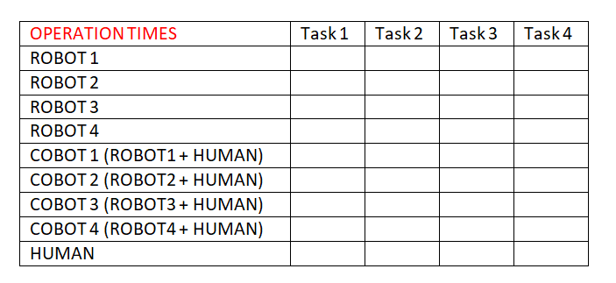
OPERATION TIME

Slide 38
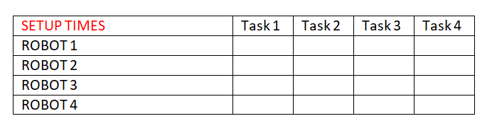
SETUP TIME

Slide 39
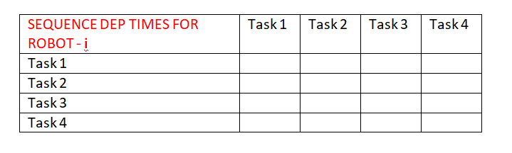
SEQUENCE DEPENDENT TIME

Slide 40
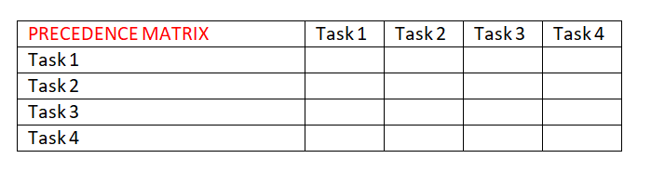
PRECEDENCE MATRIX

Slide 41
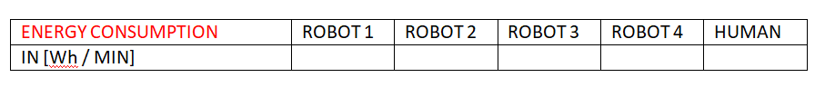
ENERGY CONSUMPTION

Slide 42
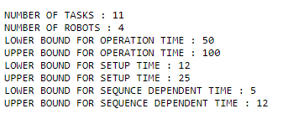
SAMPLE PROBLEM

Slide 43
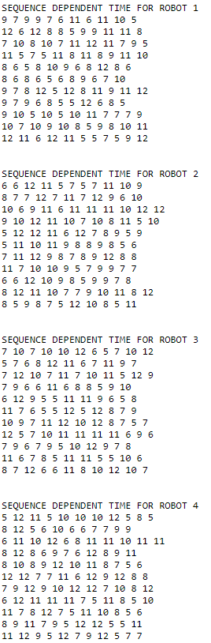
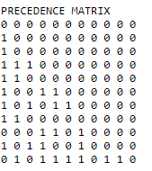

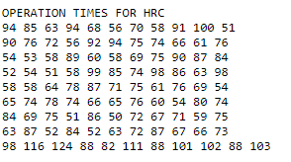


Slide 44
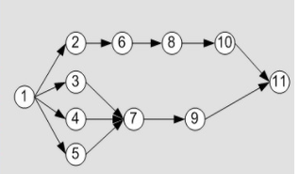
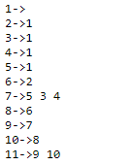
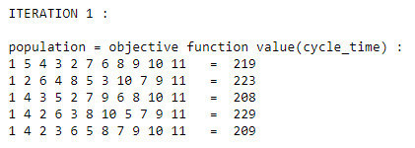
SEQUENCE GENERATION
TASK SEQUENCE GENERATION
Adjacency list that stores the precedence relation efficiently and helps in generation of sequence that satisfied these relations.
The Procedure:
First a available set is created with the tasks that has no precedence tasks.
Then one task is selected randomly from that set and the tasks following it are added in the available set.
This step is repeated until all the tasks are assigned and available set is empty.

Slide 45
ENCODING AND DECODING PROCEDURE
ENCODING AND DECODING
Each task sequence vector represents the combinations of task numbers ordered randomly and which strictly follow precedence relations.
The process alternative vector contains the resource allocation identity numbers [1-Robot/ 2-Cobot/ 3-Human] for each workstation.
Process alternative vectors follow the workstation constraint.

Slide 46
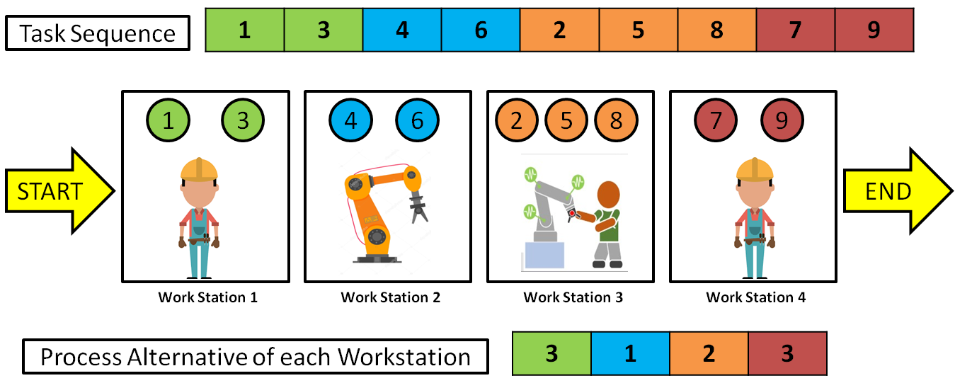
ENCODING AND DECODING
→ A sequence of tasks (following precedence relation) is used to represent the order of tasks to be performed. Similarly, a sequence of process alternatives representing numbers between 1-3 for each station representing,
1 - Only robot is allocated
2 - COBOT (robot + human) is allocated
3 - Only human is allocated
For example, a 9 tasks, 4 stations encoding sequences looks like,
TASK PERMUTATION – 1 3 4 6 2 5 8 7 9
PROCESS ALTERNATIVES - 3 1 2 3

Slide 47
Example Problem
Activities | Performance Time
 | Robot 1 | Robot 2 | Robot 3 | Robot 4 | Average Time(τ)
1 | 81 | 37 | 51 | 49 | 54.5
2 | 109 | 101 | 90 | 42 | 85.5
3 | 65 | 80 | 38 | 52 | 58.75
4 | 51 | 41 | 91 | 40 | 55.75
5 | 92 | 36 | 33 | 25 | 46.5
6 | 77 | 65 | 83 | 71 | 74
7 | 51 | 51 | 40 | 49 | 47.75
8 | 50 | 42 | 34 | 44 | 42.5
9 | 43 | 76 | 41 | 33 | 48.25
10 | 45 | 46 | 41 | 77 | 52.25
11 | 76 | 38 | 83 | 87 | 71
Precedence Graph
Performance times of 11 Activities by 4 Robots

Slide 48

Allocation of Task and Robot to stations - Consecutive Method
Calculate Initial Cycle Time Allocate activities to stations
Tasks are allocated to the stations and robots are selected which gives minimum execution time
Find the preferred set of robots for each station
where
Assign the best robot.
Repeat the procedure until all the activities are assigned.
Increment C0 if all activities are not assigned to a station
Check the cycle time of the preferred robot by adding another activity

Slide 49
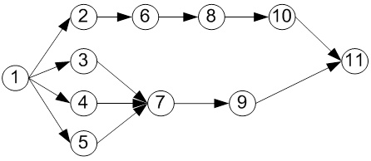
Consecutive Method
1 | 3 | 2 | 4 | 5 | 6 | 7 | 9 | 8 | 10 | 11
STATION 1
STATION 2
STATION3
STATION 4
C_{O}=109
ROBOT 1
ROBOT 2
ROBOT 3
ROBOT 4
Activities | Performance Time
 | Robot 1 | Robot 2 | Robot 3 | Robot 4
1 | 81 | 37 | 51 | 49
2 | 109 | 101 | 90 | 42
3 | 65 | 80 | 38 | 52
4 | 51 | 41 | 91 | 40
5 | 92 | 36 | 33 | 25
6 | 77 | 65 | 83 | 71
7 | 51 | 51 | 40 | 49
8 | 50 | 42 | 34 | 44
9 | 43 | 76 | 41 | 33
10 | 45 | 46 | 41 | 77
11 | 76 | 38 | 83 | 87

Slide 50
Consecutive Method
1 | 3 | 2 | 4 | 5 | 6 | 7 | 9 | 8 | 10 | 11
STATION 1
STATION 2
STATION3
STATION 4
C_{O}=109
C_{O}=143
ROBOT 1
ROBOT 2
ROBOT 3
ROBOT 4
1 , 3
1
(140)>109
(81)<109
160>109
ROBOT 2
1 , 3
142>109
1
(117)>109
(37)<109
10 , 11
8, 10 , 11
ROBOT 3
1 , 3
1, 3, 2
1
1,3
(51)<109
7, 9, 8
7, 9
(179)>109
181>109
(89)<109
89<109
ROBOT 4
1, 3, 2
1 , 3
1, 3, 2
1
1,3
4, 5, 6
(143)>109
101<109
(49)<109
(101)<109
2,4
5, 6
82<109
T=143
T=136
T=115
T=84
Not assigned to any station
Thus increment C0 until all activities are assigned to
stations

Slide 51
HUMAN ROBOT COLLABORATION IN ASSEMBLY LINE BALANCING
TASK CONSTRAINTS with respect to the ability of each type of robot, cobot(human+worker) and human in carrying out each individual task are taken into account. Inculcation of task constraints proves flexible and realistic for any entity that needs a fix to their semi-automated assembly line. In our problem, we take this into account by defining a constraint matrix that defines the “task ability/disability” (represented by 1 & 0 respectively) of all possible combinations of the 3 aforementioned workstation configuration possibilities with each listed task.
CONSTRAINT | TASK 1 | TASK 2 | TASK 3 | TASK 4 | TASK 5
ROBOT 1 | 1 | 1 | 0 | 1 | 1
ROBOT 2 | 1 | 1 | 1 | 1 | 1
ROBOT 3 | 0 | 0 | 1 | 1 | 0
COBOT 1 (robot 1 + human) | 1 | 1 | 1 | 1 | 1
COBOT 2 (robot 1 + human) | 1 | 0 | 1 | 1 | 1
COBOT 3 (robot 1 + human) | 1 | 1 | 1 | 0 | 0
HUMAN | 0 | 1 | 0 | 1 | 0

Slide 52

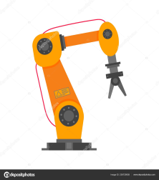
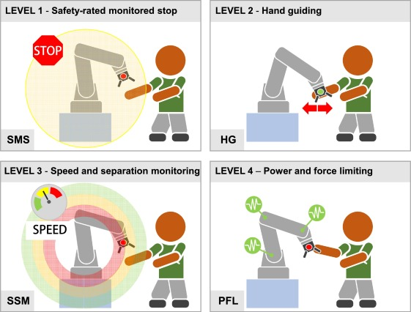



HUMAN ROBOT COLLABORATION IN ASSEMBLY LINE BALANCING
WORKSTATION CONSTRAINT is another such realistic model inculcated in line with other constraints. The constraint is such that “no two consecutive workstation shall have the same worker configuration”. This constraint adds to the practicality of limited automation investments in the line, as well as a spread in workforces, leveraging the flexibility and utter ability of humans to tackle problems at any point of the assembly line.

Slide 53
METAHEURISTIC ALGORITHMS
The base four algorithms,
PSO (particle swarm optimisation) - ALGO 1
TLBO (teaching learning based optimisation) - ALGO 2
MBO (migrating bird optimisation) - ALGO 3
AOA (archimedes optimisation algorithm) - ALGO 4
After adding the scout phase for the four algorithms developed, we now have to compare all the 8 algorithms.
And the hybrids,
PSO + ABC (particle swarm optimisation with scout phase) - ALGO 5
TLBO + ABC (teaching learning based optimisation with scout phase) - ALGO 6
MBO + ABC (migrating bird optimisation with scout phase) - ALGO 7
AOA + ABC (archimedes optimisation algorithm with scout phase) - ALGO 8

Slide 54
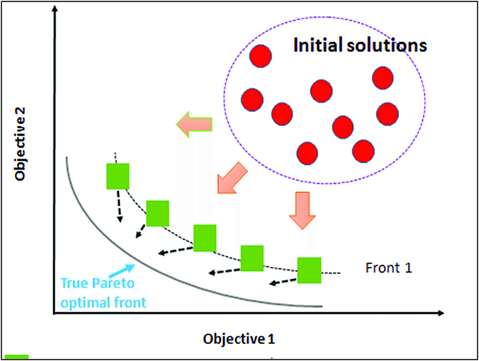
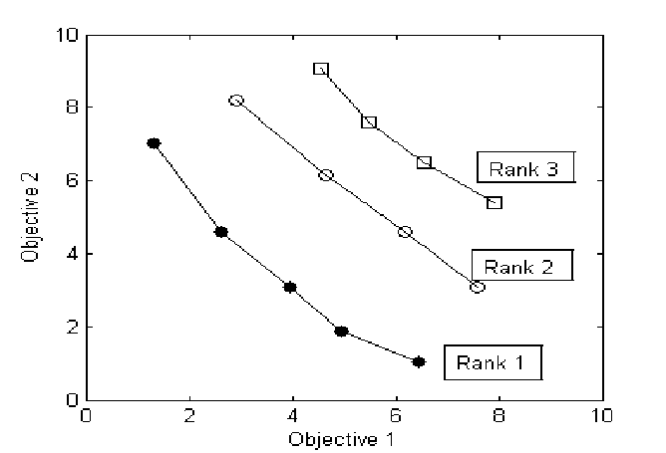
MULTI OBJECTIVE OPTIMISATION
Multi objective optimisation refers to solving multiple objectives that are conflicting in nature. As the objectives are conflicting, rather than a single optimal solution, a set of optimal solution is presented known as the pareto optimal set.
In non-dominated sorting, an individual A is said to dominate another individual B, if and only if there is no objective of A worse than objective of B.
In simple words, let us say there are two objectives f1 & f2 that is to be minimised, and two points A and B,
A dominates B if, f1(A) < f1(B) and f2(A) < f2(B)
Both lie in same front if, ( f1(A) < f1(B) and f2(A) > f2(B) ) or ( f1(A) > f1(B) and f2(A) < f2(B) )
B dominates A if, f1(A) > f1(B) and f2(A) > f2(B)
Some of the objectives in assembly line balancing problems are, To minimize the number of workstations, To minimize the cycle time, To minimize the energy consumption, To maximize the workload smoothness, etc..,

Slide 55
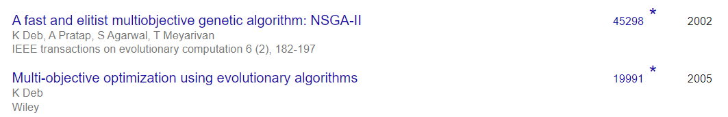
WHY NON-DOMINATED SORTING FOR MO HANDLING?
MOST COMMONLY USED METHODS TO HANDLE MULTI OBJECTIVE OPTIMISATION :-
WEIGHTED SUM METHOD - Construct a weighted sum of objectives and optimize. The difficulty with this method is that, the user must be well knowledged with the weights for each objectives as it influences the solution obtained.
CONSTRAINT METHOD - Minimize a primary objective while expressing all the other objectives in the form of inequality constraints. The difficulty with this method is that if the objectives are complex, expressing them into constraints is not effective in generating pareto optimal solutions.
NON DOMINATED SORTING WITH EXTERNAL ARCHIVE - This method as explained in the previous slide, generates many different solutions and stores them separately in an external archive.
MOST POPULARLY USED MULTI-OBJECTIVE HANDLING METHOD FOR MOST OPTIMISATION PROBLEMS:

Slide 56
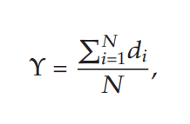
PERFORMANCE INDICATORS
PI 1 - NUMBER OF NON DOMINATED SOLUTIONS FOUND
The number of non-dominated solution generated by each algorithm in Pareto solution.
Higher PI 1 shows better algorithm performance.
PI 2 - ERROR RATIO
The number of solution which is not member of the Pareto optimal set divided by the number of solution generated by the algorithm.
Smaller PI 2 shows better algorithm performance.
PI 3 - CONVERGENCE METRIC
This metric measures the extent of convergence to a known set of Pareto optimal solutions, as follows:
where, N is the number of nondominated solutions obtained with an algorithm and,
di is the Euclidean distance between each of the nondominated solutions and the nearest member of the true Pareto optimal front.

Slide 57
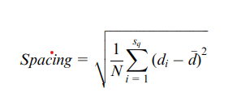
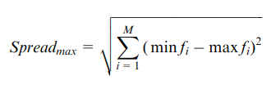

PERFORMANCE INDICATORS
PI 4 - SPACING
This indicator measures the relative distance between each solution.
where, di is the distance between solution i and the nearest solution, while d is the average of all di.
The smaller spacing index shows better solution and has better space between each solution.
PI 5 - MAXIMUM SPREAD
The spread of solution found by each algorithm.
Larger maximum spread is better.
PERFORMANCE INDICATOR | PI 1 | PI 2 | PI 3 | PI 4 | PI 5
BETTER PERFORMANCE

Slide 58
FINE TUNING OF ITERATIONS & POPULATION SIZE
The number of iterations and population size is actually given by the user, but for different sized data, the population size and iterations must be varied so that the results obtained is optimal.
To do this, all the algorithms are tested with different sized datasets namely,
Small - 0 < Number of tasks <= 50
Medium - 50 < Number of tasks <= 100
Large - Number of tasks > 100
The obtained results are compared using the performance indicators and the number of iterations and population size are fixed accordingly.
The sizes of iterations and population is considered as same to get better results. The various types tested with are,
Series 1 - T = 5 , P = 5
Series 2 - T = 10, P = 10
Series 3 - T = 15, P = 15
Series 4 - T = 20, P = 20
Series 5 - T = 25, P = 25
Series 6 - T = 30, P = 30
Where,
T = Number of iterations
P = population size

Slide 59
FINE TUNING FOR PSO
PROBLEM SIZE | PI 1 | PI 2 | PI 3 | PI 4 | PI 5 | OVERALL
Small | series 2 | series 4 | series 4 | series 1 | series 6 | series 4
Medium | series 3 | series 5 | series 5 | series 5 | series 6 | series 5
Large | series 4 | series 6 | series 3 | series 6 | series 4 | series 6
Series 1 - T = 5 , P = 5
Series 2 - T = 10, P = 10
Series 3 - T = 15, P = 15
Series 4 - T = 20, P = 20
Series 5 - T = 25, P = 25
Series 6 - T = 30, P = 30
PI 1 - number of non dominated solutions
PI 2 - error ratio
PI 3 - convergence metric
PI 4 - spacing
PI 5 - maximum spread

Slide 60
FINE TUNING FOR TLBO
PROBLEM SIZE | PI 1 | PI 2 | PI 3 | PI 4 | PI 5 | OVERALL
Small | series 3 | series 5 | series 5 | series 4 | series 3 | series 3
Medium | series 6 | series 3 | series 5 | series 6 | series 5 | series 5
Large | series 5 | series 3 | series 5 | series 4 | series 3 | series 5
Series 1 - T = 5 , P = 5
Series 2 - T = 10, P = 10
Series 3 - T = 15, P = 15
Series 4 - T = 20, P = 20
Series 5 - T = 25, P = 25
Series 6 - T = 30, P = 30
PI 1 - number of non dominated solutions
PI 2 - error ratio
PI 3 - convergence metric
PI 4 - spacing
PI 5 - maximum spread

Slide 61
FINE TUNING FOR MBO
PROBLEM SIZE | PI 1 | PI 2 | PI 3 | PI 4 | PI 5 | OVERALL
Small | series 6 | series 4 | series 6 | series 4 | series 5 | series 4
Medium | series 6 | series 5 | series 5 | series 3 | series 5 | series 5
Large | series 5 | series 6 | series 6 | series 3 | series 5 | series 6
Series 1 - T = 5 , P = 5
Series 2 - T = 10, P = 10
Series 3 - T = 15, P = 15
Series 4 - T = 20, P = 20
Series 5 - T = 25, P = 25
Series 6 - T = 30, P = 30
PI 1 - number of non dominated solutions
PI 2 - error ratio
PI 3 - convergence metric
PI 4 - spacing
PI 5 - maximum spread

Slide 62
FINE TUNING FOR AOA
PROBLEM SIZE | PI 1 | PI 2 | PI 3 | PI 4 | PI 5 | OVERALL
Small | series 4 | series 5 | series 6 | series 5 | series 4 | series 5
Medium | series 4 | series 5 | series 6 | series 2 | series 6 | series 6
Large | series 4 | series 6 | series 6 | series 6 | series 5 | series 6
Series 1 - T = 5 , P = 5
Series 2 - T = 10, P = 10
Series 3 - T = 15, P = 15
Series 4 - T = 20, P = 20
Series 5 - T = 25, P = 25
Series 6 - T = 30, P = 30
PI 1 - number of non dominated solutions
PI 2 - error ratio
PI 3 - convergence metric
PI 4 - spacing
PI 5 - maximum spread

Slide 63
OVERALL CONCLUSION OF ITERATIONS & POPULATION SIZE FINE TUNING
ALGORITHM | PSO | TLBO | MBO | AOA
SMALL | T = 20, P = 20 | T = 15, P = 15 | T = 20, P = 20 | T = 25, P = 25
MEDIUM | T = 25, P = 25 | T = 25, P = 25 | T = 25, P = 25 | T = 30, P = 30
LARGE | T = 30, P = 30 | T = 25, P = 25 | T = 25, P = 25 | T = 30, P = 30

Slide 64
OVERALL CONCLUSION OF PARAMETERS FINE TUNING
ALGORITHM | PSO | TLBO | MBO | AOA
SMALL | c1 = [0 - 0.5] c2 + c3 <= 1.5 | Tf = [0 - 0.5] r + Tp <= 1.5 | K = 5 X = 3 | -------
MEDIUM | c3 = [0.5 - 1] c1 + c2 <= 1.5 | Tp = [0.5 - 1] r + Tf <= 1.5 | K = 3 X = 1 | -------
LARGE | c2 = [0.5 - 1] c1 + c3 <= 1.5 | Tf = [0 - 0.5] r + Tp <= 1.5 | K = 5 X = 2 | -------

Slide 65
CONSOLIDATED RESULT
PROBLEM SIZE | Algo 1 | Algo 2 | Algo 3 | Algo 4 | Algo 5 | Algo 6 | Algo 7 | Algo 8 | OVERALL
Small | 0 | 0 | 0 | 0 | 0 | 2 | 5 | 3 | ALGO 7
Medium | 0 | 0 | 0 | 1 | 2 | 1 | 4 | 6 | ALGO 8
Large | 0 | 0 | 0 | 0 | 3 | 3 | 6 | 6 | ALGO 8
PSO - Algo 1
TLBO - Algo 3
MBO - Algo 5
AOA - Algo 7
PSO + ABC - Algo 2
TLBO + ABC - Algo 4
MBO + ABC - Algo 6
AOA + ABC - Algo 8

Slide 66
CONCLUSION
Research on HRCALB is in infant stage.
ALB itself is a NP-hard problem. So, HRC further adds complexity to the problem.
Hence, Meta-heuristic algorithms are the only means to solve this problem.
PSO, TLBO, MBO & AOA are the four algorithms proposed.
Scout phase of ABC has been hybridized with these four algorithms.
Cycle time & Energy are two performance measures considered.
To evaluate a total of eight algorithms, Five performance criteria were chosen.
Novel Data Generation technique has been proposed for HRCALB problem.
The parameters in each of the algorithms were fine tuned.
Using those performance indicators, the results were such that:
Small problem – AOA
Medium problem – AOA + ABC
Large problem – AOA + ABC

Slide 67
LIMITATIONS & FUTURE RESEARCH DIRECTIONS
The problem assumes Data generated according to the user, but the actual industrial data might differ from the assumed data set.
The constraints in the industries are highly complex, which needs further research on this topic to address.
The resource allocation done using consecutive method assumes infinitely available sources, which is not ideal in real life industries.
A standard data set for HRC can be developed.

Slide 68
References
Rubinovitz, Jacob, Joseph Bukchin, and Ehud Lenz. "RALB–A heuristic algorithm for design and balancing of robotic assembly lines." CIRP Annals-Manufacturing Technology 42, no. 1 (1993): 497-500.
TSAI, DU-MING, and MING-JONG YAO. "A line-balance-based capacity planning procedure for series-type robotic assembly line." The International Journal Of Production Research 31, no. 8 (1993): 1901-1920.
Kim, Hyoungtae, and Sungsoo Park. "A strong cutting plane algorithm for the robotic assembly line balancing problem." International Journal of Production Research 33, no. 8 (1995): 2311-2323.
Bukchin, Joseph, and Michal Tzur. "Design of flexible assembly line to minimize equipment cost." Iie transactions32, no. 7 (2000): 585-598.
Levitin, Gregory, Jacob Rubinovitz, and Boris Shnits. "A genetic algorithm for robotic assembly line balancing." European Journal of Operational Research 168, no. 3 (2006): 811-825.
Gao, Jie, Linyan Sun, Lihua Wang, and Mitsuo Gen. "An efficient approach for type II robotic assembly line balancing problems." Computers & Industrial Engineering 56, no. 3 (2009): 1065-1080.

Slide 69
References
Nilakantan, J. Mukund, S. G. Ponnambalam, N. Jawahar, and Ganesan Kanagaraj. "Bio-inspired search algorithms to solve robotic assembly line balancing problems." Neural Computing and Applications 26, no. 6 (2015): 1379-1393.
Mukund Nilakantan, J., and S. G. Ponnambalam. "Robotic U-shaped assembly line balancing using particle swarm optimization." Engineering Optimization 48, no. 2 (2016): 231-252.
Li, Zixiang, Mukund Nilakantan Janardhanan, Qiuhua Tang, and Peter Nielsen. "Co-evolutionary particle swarm optimization algorithm for two-sided robotic assembly line balancing problem." Advances in Mechanical Engineering 8, no. 9 (2016): 1687814016667907.
Çil, Zeynel Abidin, Süleyman Mete, and Kürşad Ağpak. "Analysis of the type II robotic mixed-model assembly line balancing problem." Engineering Optimization 49, no. 6 (2017): 990-1009.
Tang, Qiuhua, Zixiang Li, and Liping Zhang. "An effective discrete artificial bee colony algorithm with idle time reduction techniques for two-sided assembly line balancing problem of type-II." Computers & Industrial Engineering 97 (2016): 146-156.
Daoud, Slim, Hicham Chehade, Farouk Yalaoui, and Lionel Amodeo. "Solving a robotic assembly line balancing problem using efficient hybrid methods." Journal of Heuristics 20, no. 3 (2014): 235-259.

Slide 70
References
Nilakantan, J. Mukund, George Q. Huang, and S. G. Ponnambalam. "An investigation on minimizing cycle time and total energy consumption in robotic assembly line systems." Journal of Cleaner Production 90 (2015): 311-325.
Nilakantan, J. Mukund, Izabela Nielsen, S. G. Ponnambalam, and S. Venkataramanaiah. "Differential evolution algorithm for solving RALB problem using cost-and time-based models." The International Journal of Advanced Manufacturing Technology 89, no. 1-4 (2017): 311-332.
Nilakantan, Mukund J., S. G. Ponnambalam, and N. Jawahar. "Design of energy efficient RAL system using evolutionary algorithms." Engineering Computations 33, no. 2 (2016): 580-602.
Nilakantan, J. Mukund, Zixiang Li, Qiuhua Tang, and Peter Nielsen. "Multi-objective co-operative co-evolutionary algorithm for minimizing carbon footprint and maximizing line efficiency in robotic assembly line systems." Journal of cleaner production 156 (2017): 124-136.
Çil, Zeynel Abidin, Süleyman Mete, and Kürşad Ağpak. "A goal programming approach for robotic assembly line balancing problem." IFAC-PapersOnLine 49, no. 12 (2016): 938-942.
Li, Zixiang, Mukund Nilakantan Janardhanan, Qiuhua Tang, and Peter Nielsen. "Mathematical model and metaheuristics for simultaneous balancing and sequencing of a robotic mixed-model assembly line." Engineering Optimization 50, no. 5 (2018): 877-893.
Nilakantan, Janardhanan Mukund, S. G. Ponnambalam, and Peter Nielsen. "Energy-Efficient Straight Robotic Assembly Line Using Metaheuristic Algorithms." In Soft Computing: Theories and Applications, pp. 803-814. Springer, Singapore, 2018.

Slide 71

End of Presentation
Thank you for your patience and attention

